Slide 1
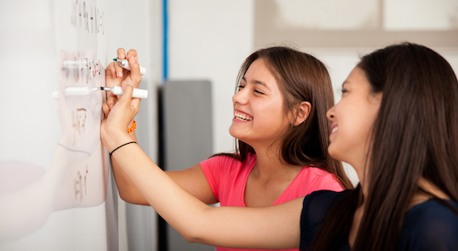
Problem Solving Session
The remainder of today’s class will comprise the problem solving session (PSS).
Your instructor will divide you into teams of 3 or 4 students.
Each team will work together to solve the following problems over the course of 20-30 minutes.
You may work on paper, a white board, or digitally as determined by your instructor.
You will submit your solution by pushing it to GitHub before the end of class.
Your instructor will go over the solution before the end of class.
If there is any time remaining, you will begin work on your homework assignment.
Class participation is a significant part of your grade (20%). This includes in class activities and the problem solving session.
Your Course Assistants will grade your participation by verifying that you pushed your solutions before the end of the class period each day.

Slide 2
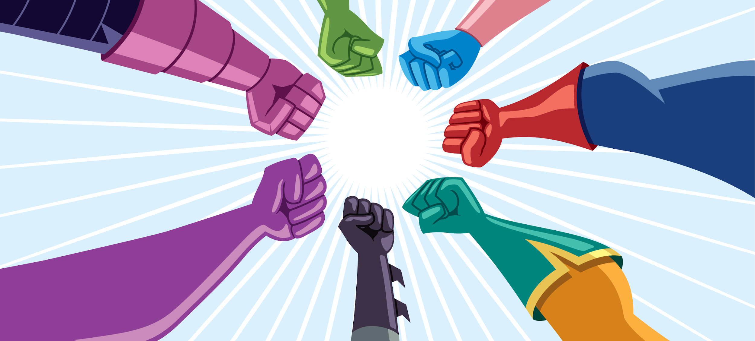
Problem Solving Team Members
Zach Kroesen
Joseph Casale
JP Dumont
Addo Davies
Jonathan Cruz
Jake Downie
Record the name of each of your problem solving team members here.
Do not forget to add every team member’s name! Your instructor (or course assistant) may or may not use this to determine whether or not you participated in the problem solving session.

Slide 3
Problem Solving 1
What happens when you press
5 + 8 =
13
What happens when you then press
- 4 =
-4
What happens if you then press
* 8 =
0
In words, describe the process for handling user input given the previous illustrations
Take Input.
Evaluate.
Print result.
For this assignment you'll be creating a network calculator. However, before starting, take a few minutes to analyze how a simple calculator works. This will help you better understand what is going on at the user interface level.
Use the simple calculator at Simple Calculator (calculator-1.com) to answer the following questions on the right.

Slide 4
Problem Solving 2
Client Lines: 1 - 4
Given the following code for a stand alone calculator, when converted to a network calculator, which lines would be in the client and which would be in the server?
Hint: The client is responsible for everything the user sees and the server does all the calculations.
1 Calculator calculator = new Calculator (OPS);
2 Scanner in = new Scanner (System.in);
3 System.out.print ("Enter math operation: ");
4 String input = in.nextLine ();
5
6 while (!input.equals(" ")) {
7 String[] tokens = input.strip().split(" ");
8 String result;
9 float operand1 = Float.parseFloat(tokens[0]);
10 float operand2 = Float.parseFloat(tokens[2]);
11 result = calculator.calculate(tokens[1],
12 operand1, operand2) + "";
13 System.out.print (result);
14 }
Server Lines: 6 - 14

Slide 5
Problem Solving 3
DatagramSocket server = new DatagramSocket(12400);
Byte[] buffer = new byte[1024];
DatagramPacket packet = new DatagramPacket(buffer, buffer.length);
server.receive(packet);
String message = new String(packet.getData(), 0, packet.getLength());
System.out.println(message);
The server will receive messages from the client on port 12400 using UDP. Write the code necessary to receive one DatagramPacket on port 12400.
Refer to the example from class if you need to.

Slide 6
Problem Solving 4
DatagramSocket s = new DatagramSocket();
String m = “Hello world!”
DatagramPacket p = new DatagramPacket(m.getBytes(), m.length(), “se.rit.edu”, 42100);
s.send(p);
Sending text data using UDP involves the following steps.
Make a socket to send the data with.
Convert the text data from a String into a byte array.
Add the byte array to a packet that is addressed to the recipient.
Send the packet using the socket.
In the space on the left, write the Java code necessary to send the String "I Love Java" to "se.rit.edu" on port 42100 using UDP.

